Slide 1
“Speeding Up” The Traveling Salesman Problem in R
Ralph Asher
https://www.linkedin.com/in/ralphasher/
https://github.com/ralphasher

Slide 2


Who Am I? Where am I? Why am I?
BS Physics, Valparaiso University (Indiana)
MS Operations Research, Florida Institute of Technology
R user since 2012
Math and map enthusiast since ~1990
Supply Chain Analytics 2013 – present, General Mills and Target
BI, statistical modeling, optimization, simulation, heuristic algorithm development… and SQL… and Excel Pivot Tables
Purpose of this talk: using R as a general purpose mathematical language to link together various analytical techniques, towards a large and impactful business problem

Slide 3
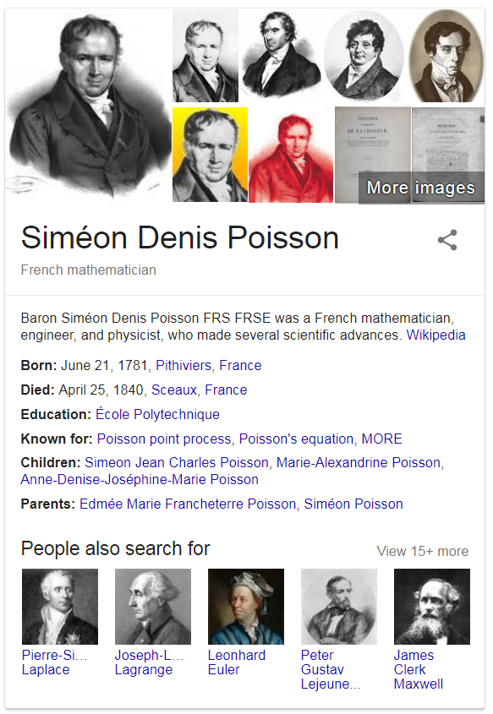



Slide 4
What’s Ahead
Intro to Operations Research and the Traveling Salesman Problem
Example TSP in R
Real world driving approximation with R and the TSP

Slide 5
Operations Research
“A discipline that deals with the application of advanced analytical methods to help make better decisions… It is often considered to be a sub-field of applied mathematics”… Story problems … origins in WW2 Britain
Operations Research problems all have constraints around managerial decisions (must do, and cannot do) and objective functions (what metrics to maximize or minimize, considering the constraints)
E-Commerce: where to place warehouses to meet two-day shipping to all customers, at the lowest cost?
Workforce planning: how to schedule workers at a call center to meet anticipated call volume, within maximum allowed caller wait time, and minimizing staffing?
Bike Shares (e.g. Nice Ride): how to re-balance bikes between docking stations as efficiently as possible to meet rider demand?
Notes:
From The Wikipedia… In honor of George W Bush, who spoke about The Google.
BUT I AM NOT GOING TO TALK ABOUT ANY OF THESE THINGS. Based upon a disguised project I did

Slide 6

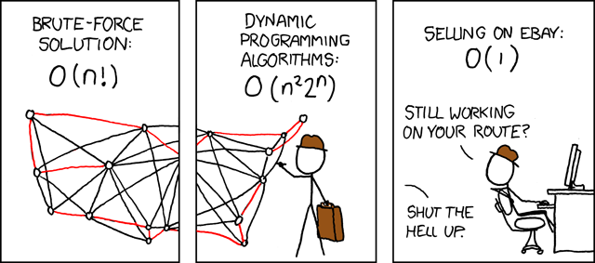


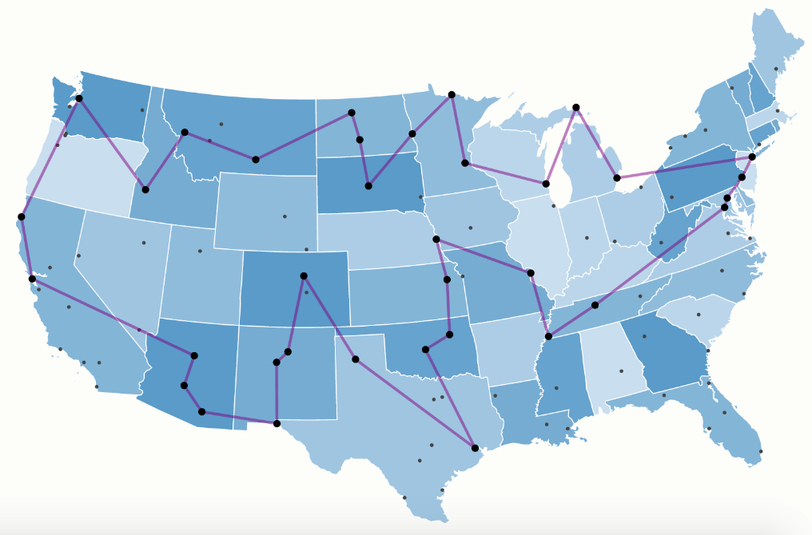
The Traveling Salesman…
Notes:
Depending upon your familiarity with the Traveling Salesman, you may think of these things…
<STRANGER DANGER>
<I’m not a Minnesotan, but I’ve heard these guys are popular>
<Now here’s one I’m guessing most of this room could identify >
< Getting closer >
< If you get this reference, you’re a ringer… and don’t ask me any hard questions {Concorde is a high-end solver for the TSP} >

Slide 7
The Traveling Salesman Problem
"Given a list of cities and the distances between each pair of cities, what is the shortest possible route that visits each city and returns to the origin city?“ (route is called a “tour”)
Logistics… and microchip manufacturing
Some variants on the question – do I get to pick my origin? Is the distance from A to B the same as from B to A?
Number of routes with n cities is:
n! if you pick your origin and routes are not symmetric (e.g., d_ab <> d_ba) . n options for the origin city, (n-1) options for second city, (n-2) options for third city…. Until 1 option for final city prior to return to origin
n!/2 if you pick the origin, and routes are symmetric
(n-1)! Instead of n! if the origin city is pre-selected
Notes:
I originally thought NP meant “not possible” – my computer science instructor told me otherwise when I got my exam back
Lots of benefits to be able to move as efficiently as possible along a very large number of routes
We’ll be looking at the n!/2 case – routes are symmetric but we pick the origin city - ~239.5M routes.

Slide 8
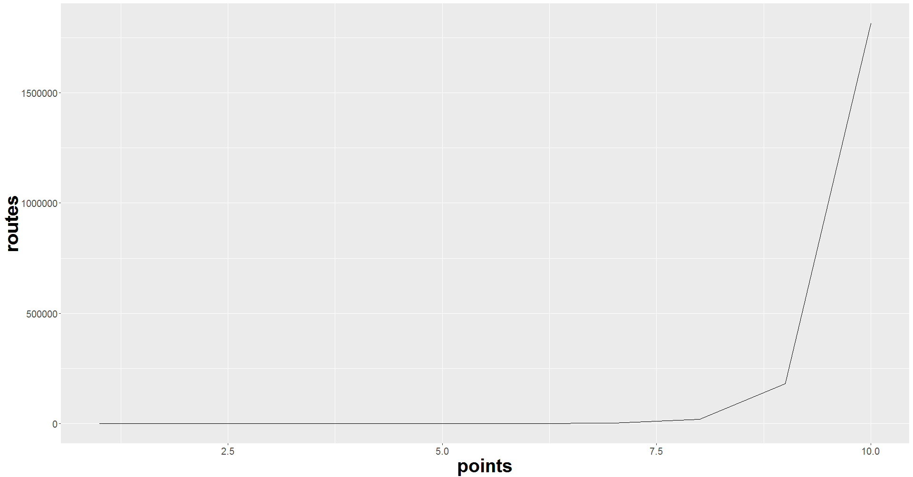
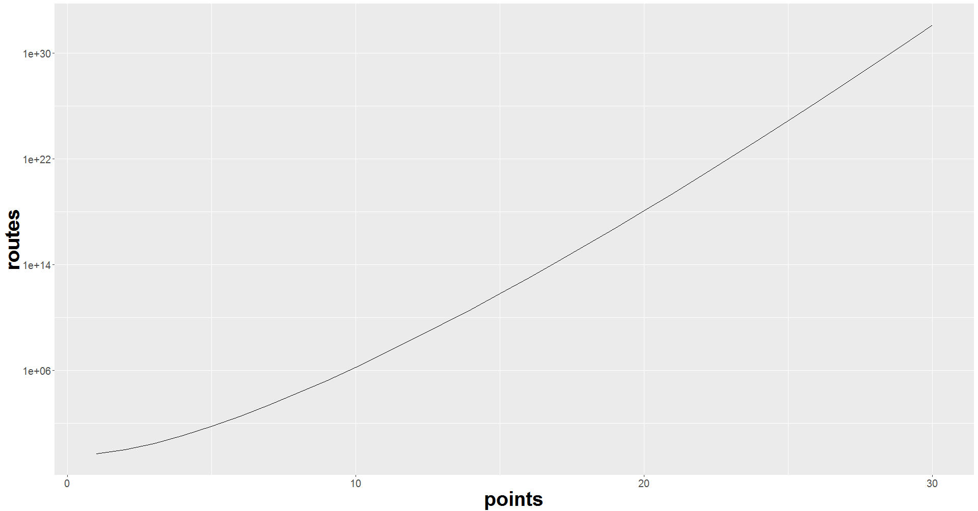
Number of routes grows exponentially: (n!/2)
From 1 to 10 cities, continuous scale
From 1 to 30 cities, log scale
Notes:
Assuming we pick our origin city and
5 points = 5!/2 = 60 routes
6 points = 6!/2 = 360 routes
10 points = 10!/2 = 1.8M routes
So now let’s look at a situation with 12 points, 12!/2 = 239.5M routes

Slide 9
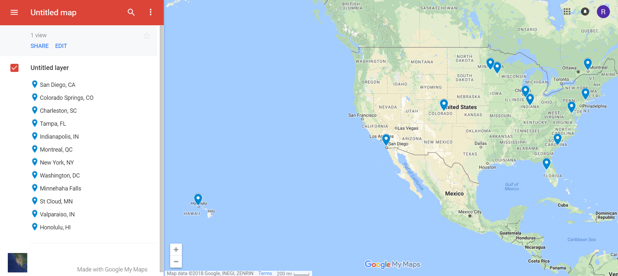
My Own Personal Forrest Gump Mission…
Notes:
12!/2 = 239.5M routes . Need to use heuristics here.

Slide 10


Quick Now! To the Markdown!

Slide 11
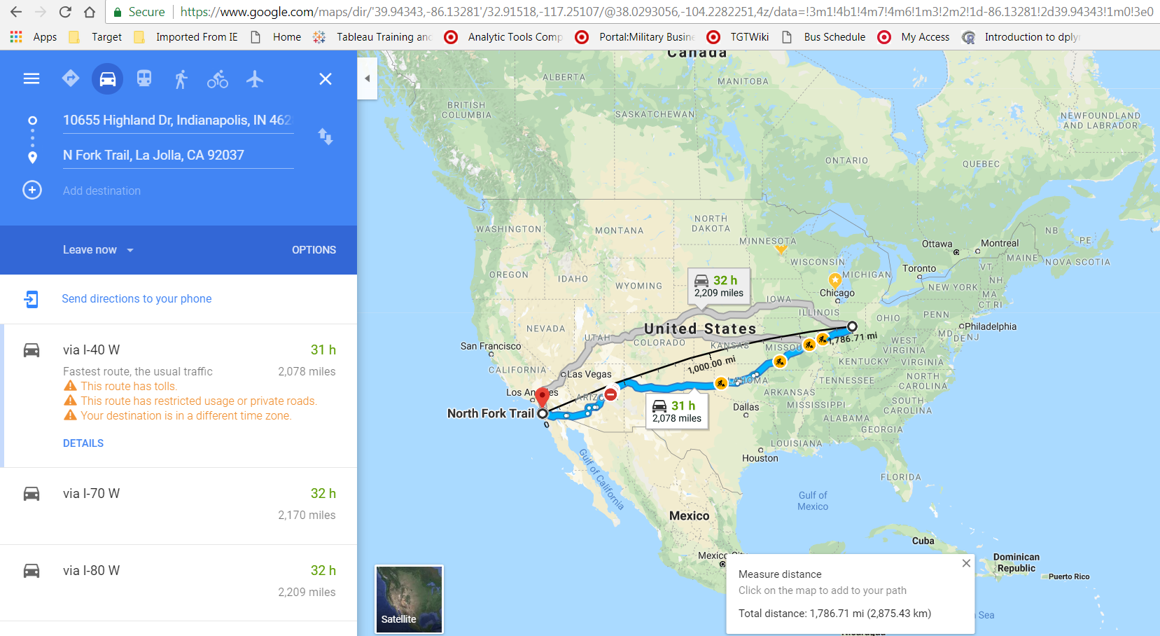

Slide 12
Conclusion
R is a fantastic language for enabling analytical creativity
“Triple Constraint” of Problem Solving: domain knowledge, analytical conceptual knowledge, technical implementation knowledge
The TSP is readily solved in R
Supply Chain is a great field for data science!

Slide 13
Question Time…

Slide 14
But Wait, I’m Not a Crow! I drive!
Real life routing should not just use straight-line distance
Road distance between two points is longer than the straight-line distance – so you need to apply a multiplier to a straight-line distance to estimate road distance and travel times
Multipliers are endpoint-specific… and vary by distance

Slide 15
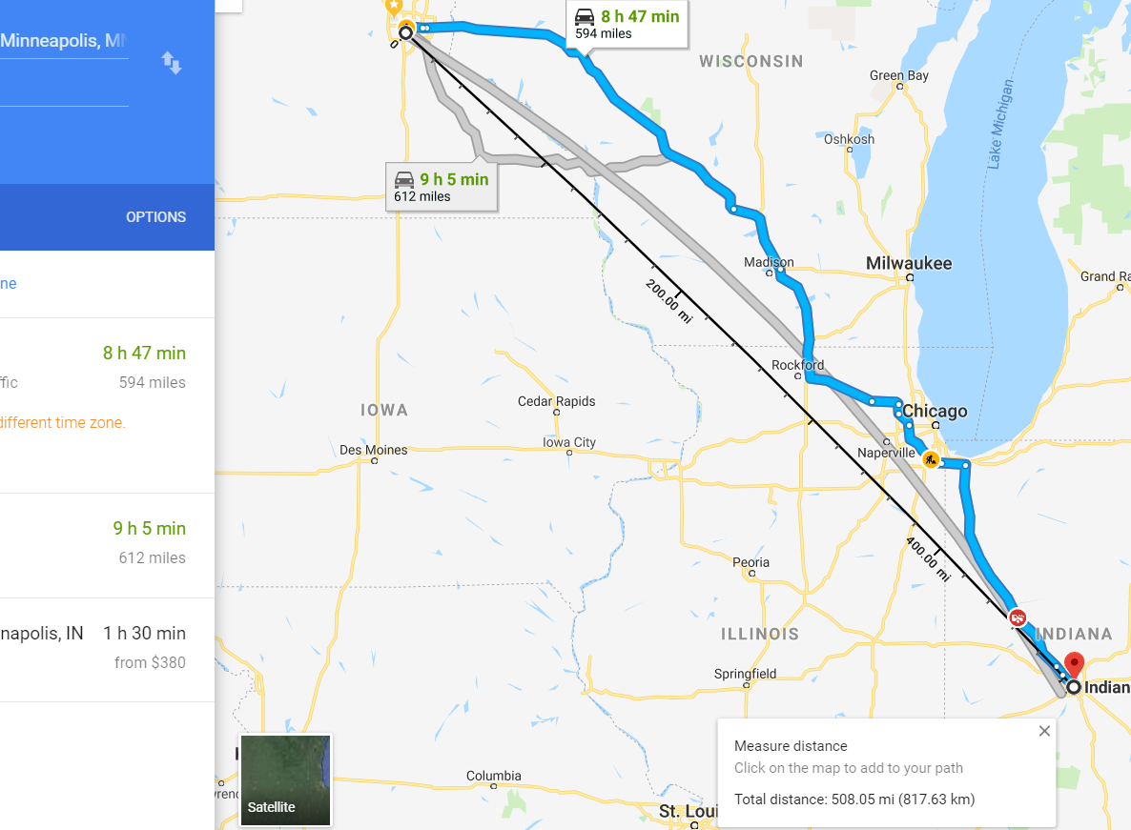
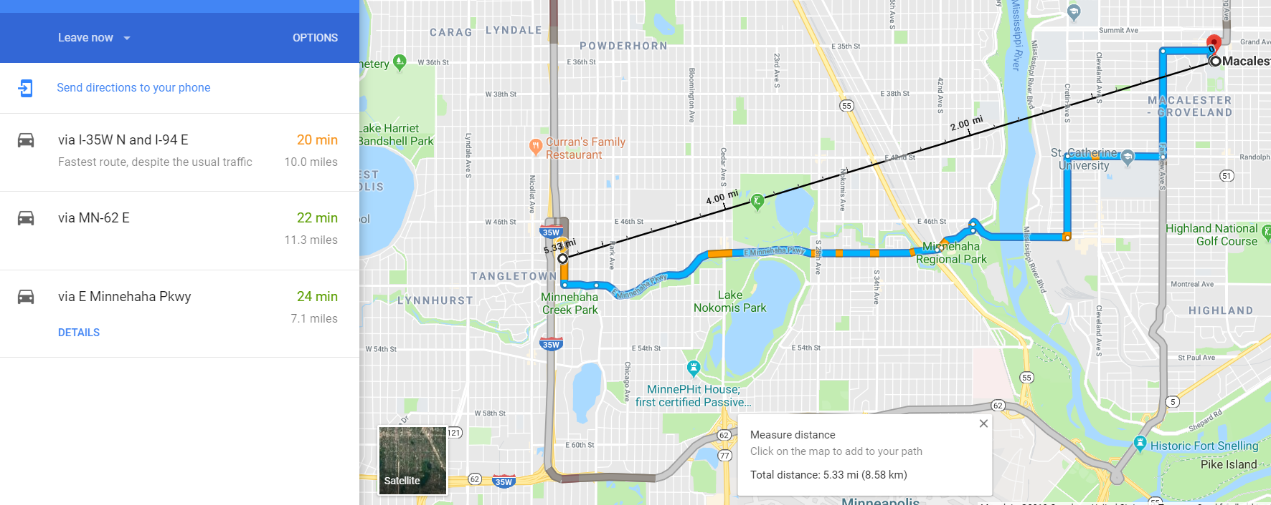
Straight-line Distance / Drive Distance Comparison
Home to Indianapolis: 594 drive miles / 508 straight-line miles
= 1.17 drive miles per straight-line mile
Home to Macalester: 7.1 drive miles / 5.33 straight-line miles
= 1.33 drive miles per straight-line mile

Slide 16
Straight-line Distance / Drive Time (Minutes) Comparison
Home to Indianapolis: 8h47 minutes drive time / 508 straight-line miles
= 1.04 minutes per straight-line mile
Home to Macalester: 24 minutes drive time / 5.33 straight-line miles
= 4.5 minutes per straight-line mile
Notes:
The further the straight-line distance, the lower these ratios are.
The road mile to straight-line mile ratio is a measure of how direct a path we can get. Closer to 1, the better.
The drive minutes to straight-line mile ratio is a measure of how fast we are traveling the route. Typically the farther the trip, the faster a route we can find.
So we may expect that in aggregate, both these ratios decline as trips increase in straight-line distance.
Say you’re starting a delivery service, and hiring delivery drivers and they get paid by the hour and by the mile. You need a way to reasonably estimate the drive time/distance , and thus cost, associated with routes you are considering. And by the way, you have to consider thousands of possible routes, depending upon how popular your service is. You can’t use Google Maps for all these.

Slide 17
The Conundrum…
Straight-line distance calculation is very fast in R
Google Maps API is very slow for all but the smallest problems… and it doesn’t always give reasonable answers. And… API limits.
How to reasonably estimate drive time and drive distance from straight-line distance?
Answer: estimate multipliers that are straight-line-distance-specific
If A to B is 10 miles, then assume it is 10x driving miles, and 10y driving minutes
If C to D is 35 miles, then assume it is 35z driving miles, and 35q driving minutes

Slide 18
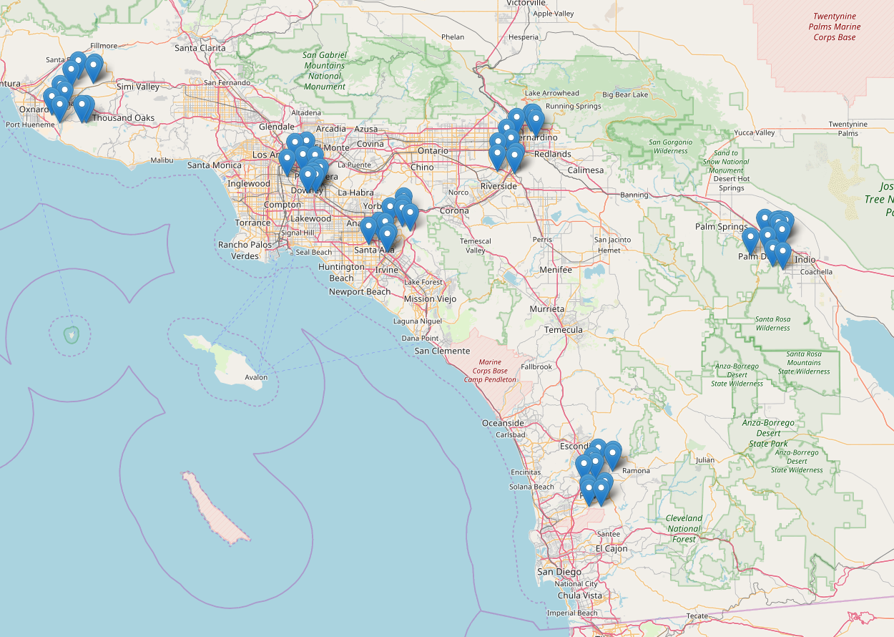
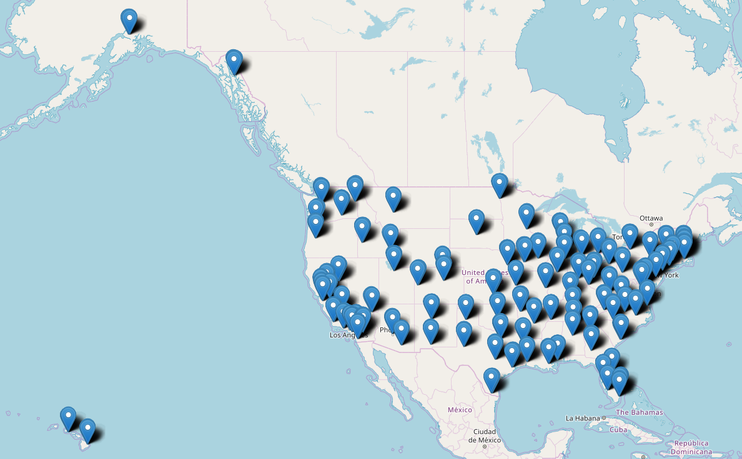
Methodology
Generate 1000 random latitude longitude across the country
Create straight-line distance matrix (dedicate a Friday morning)
Create empty matrices for drive times and drive distances
Set a script to query mapping API for each pair (do this Friday afternoon and walk away)

Slide 19
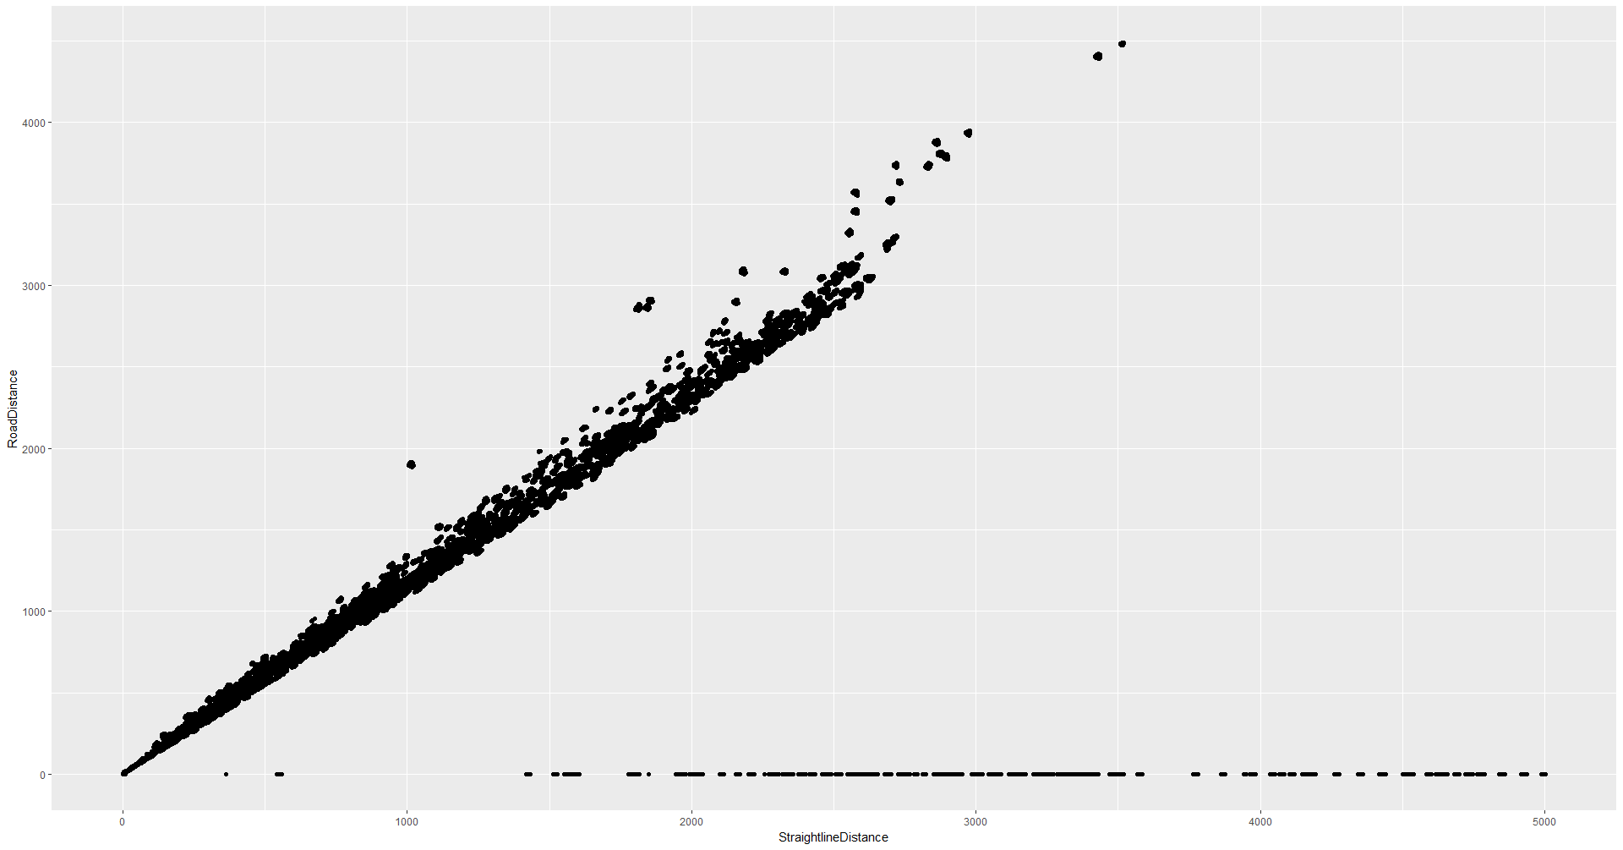
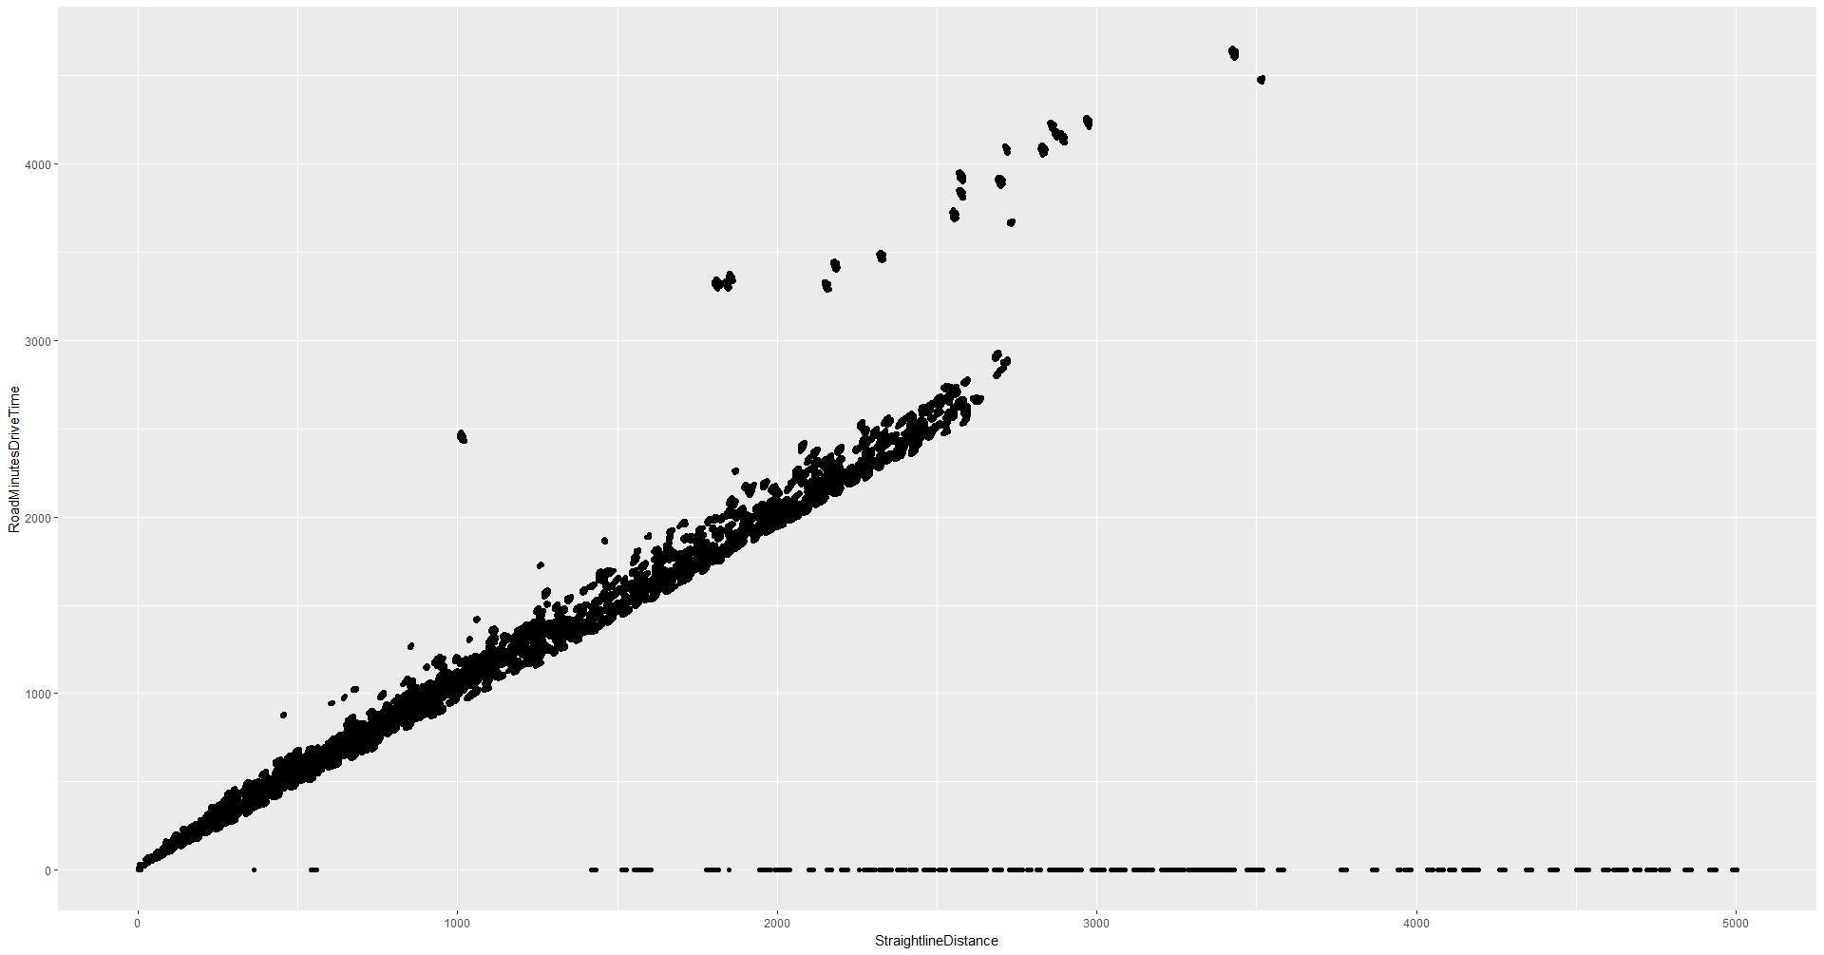
Plot Straight-line Distance vs. Road Distance and vs. Drive Times
We have some data quality issues … or we have figured out teleportation

Slide 20
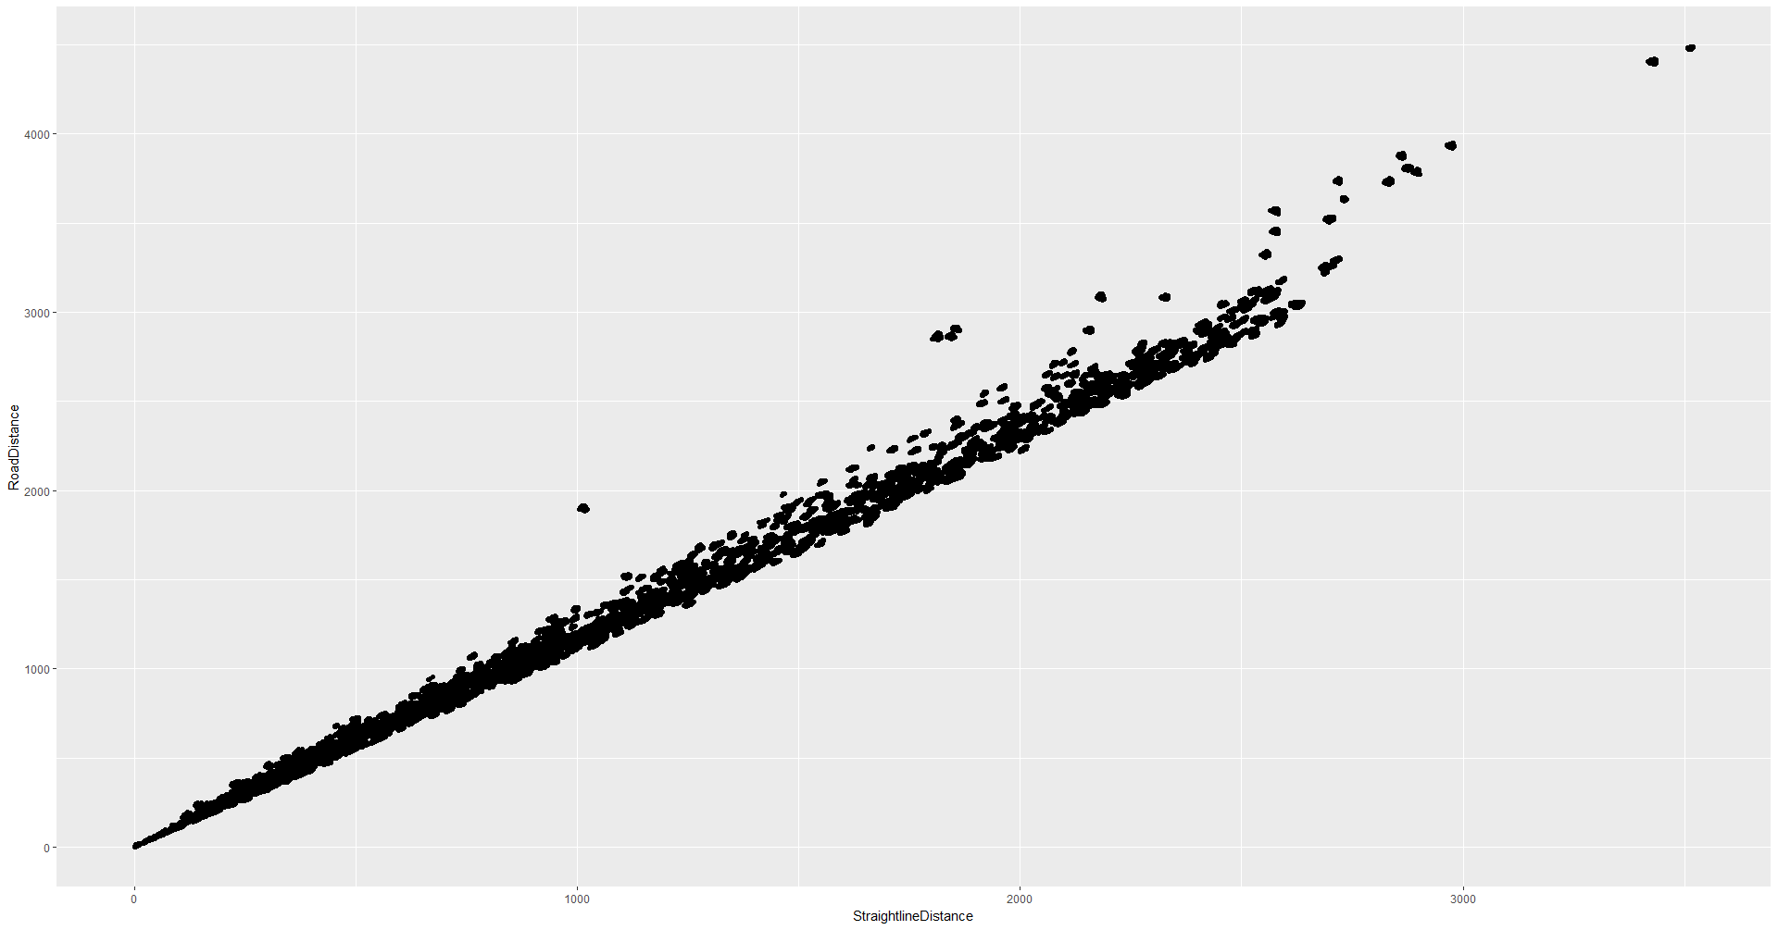
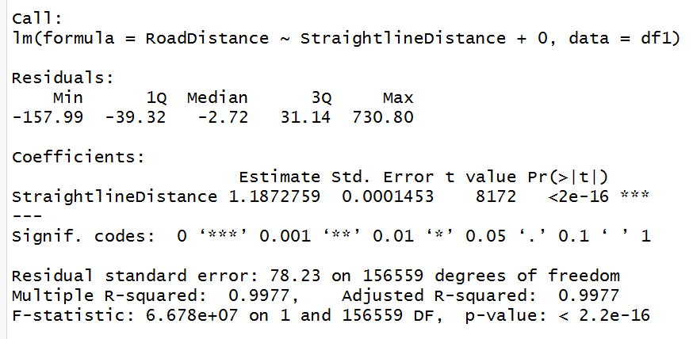
After filtering zero-distance results from Bing…
Notes:
Very good r squared, and this intercept is very close to the long-distance ratio we found from Mpls to Indianapolis. But the majority of the distances in our dataset are “long” (not local) distances so that may be hiding the appropriate ratios for shorter trips… like the kind we’re making in our delivery service.

Slide 21
Window Regression
To find the multiplier values at straight-line distance = 3 miles, there are very few (if any) observations in our dataset with that exact distance.
Define “windows” around each straight-line value and perform regression upon the subset of the dataset within that window
Example, define a window of +/- 2 straight-line miles
To find the multipliers at 7 straight-line miles, subset the results to rows between 5 and 9 straight-line miles
Perform linear regression on each window, and record results for multipliers

Slide 22
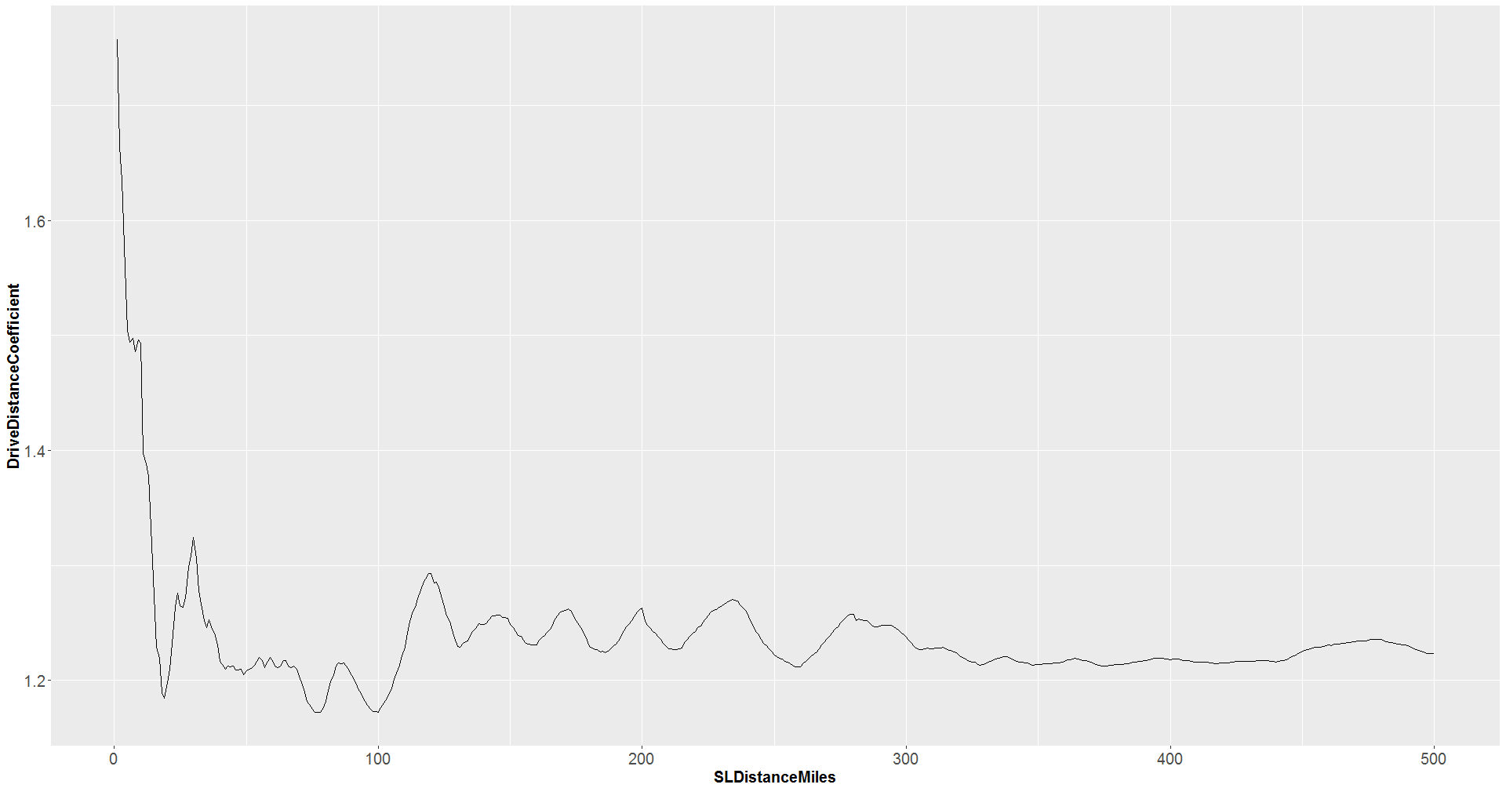
Notes:
Our trip from Mpls to Indianapolis (508 straight-line miles) had a slightly lower multiplier than the analysis regression output (1.18 vs. ~1.22)
But we can generally see that the longer the trip, the better this

Slide 23
So… how is this useful?
Estimating local delivery routes (time, distance, and cost) need to have realistic travel times
Using Google Maps API for tens of thousands of routes… not quick
Using R’s straight-line distance functions – quick! Then just multiplying these by the empirical factors
“Front loads” the complexity of approximating actual travel time, with some loss of precision
Could be improved to approximate local conditions

Slide 24
Conclusion
R is a fantastic language for enabling analytical creativity
The TSP is readily solved in R
Supply Chain is a great field for data science!

